Slide 1

MapReduce Architecture
Ram Krishna Pudasaini
Roll: 24

Slide 2
What is Mapreduce?
Definition: MapReduce is a programming model and processing framework for distributed computing.
Origin: Popularized by Google and implemented in open-source frameworks like Apache Hadoop.
Purpose: Designed to handle massive datasets across clusters of computers efficiently.

Slide 3
Key Components of MapReduce
JobTracker
Description: Master daemon responsible for job scheduling, task assignment, and monitoring.
Functionality: Accepts job submissions, coordinates task execution across nodes.
Example: In Hadoop, JobTracker manages MapReduce jobs.
TaskTrackers
Description: Worker daemons running on individual cluster nodes.
Functionality: Execute tasks assigned by the JobTracker, send status updates.
Example: Each node may have multiple TaskTrackers, executing map and reduce tasks.
Client Program

Slide 4
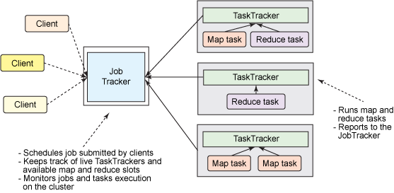
How do Job Tracker works?

Slide 5
Key Components of MapReduce
MapReduce Job
Description: Main processing unit consisting of map and reduce phases.
Map Phase: Applies a function to input data, generates intermediate key-value pairs.
Reduce Phase: Aggregates and processes intermediate pairs, produces final output.
OutputFormat
Description: Specifies the format of final output data produced by the MapReduce job.
Functionality: Defines how output is written and stored.
Example: Various OutputFormats available, including text, sequence, and custom formats.
Input Split

Slide 6
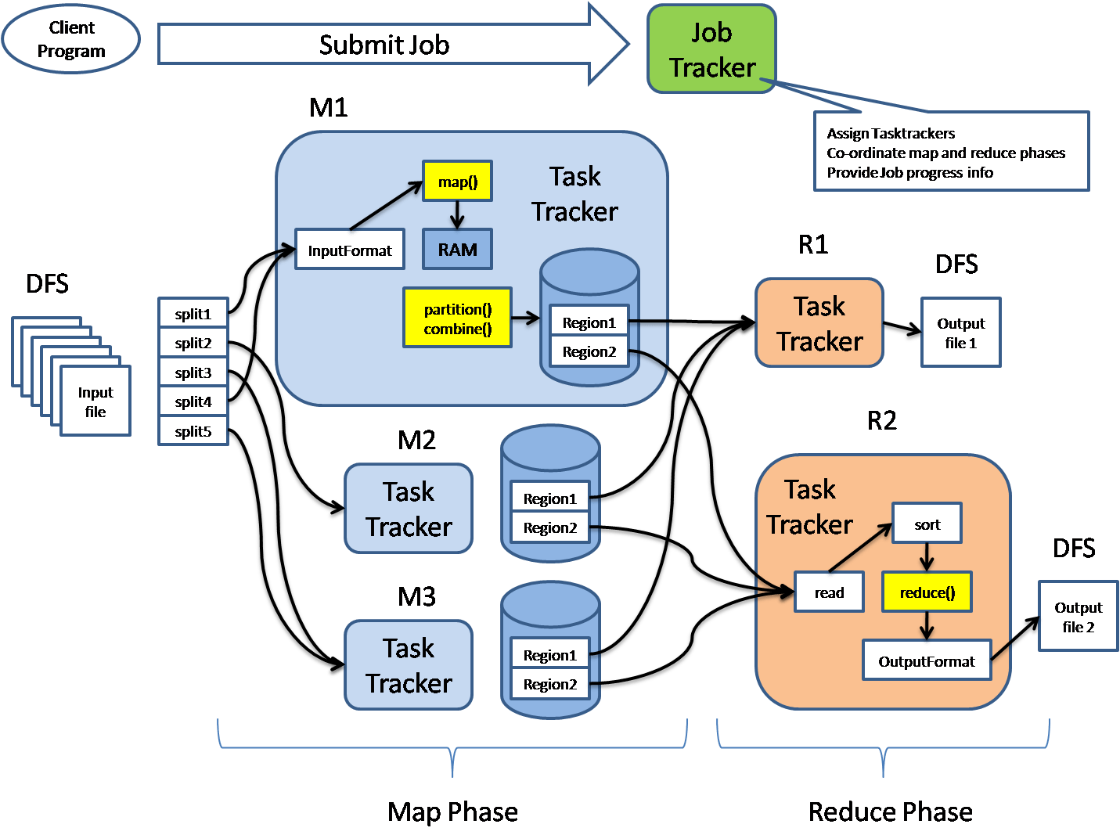

Slide 7
Combiner
Purpose: The Combiner, also known as the mini-reducer, is an optional optimization technique employed during the MapReduce framework's shuffle and sort phase.
Functionality: After the Map phase, before the data is transferred over the network to the reducers, the Combiner aggregates the intermediate key-value pairs produced by the mapper tasks locally on each node. It performs a "mini-reduction" operation on these pairs.

Slide 8
Partitioner
Purpose: The Partitioner is responsible for determining which reducer instance will receive the output of each map task based on the intermediate keys.
Functionality: It partitions (divides) the intermediate key-value pairs produced by the mapper tasks into groups or partitions, ensuring that all key-value pairs with the same key end up in the same partition.

Slide 9
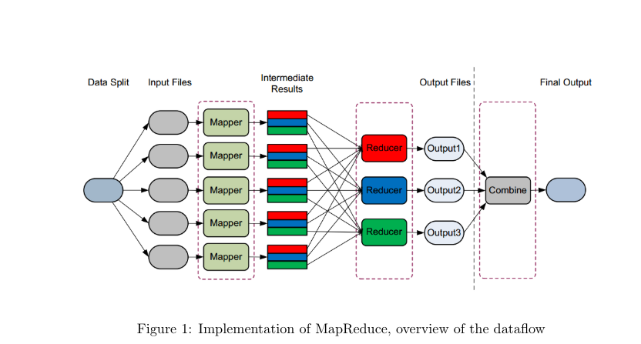
Mapreduce Workflow

Slide 10
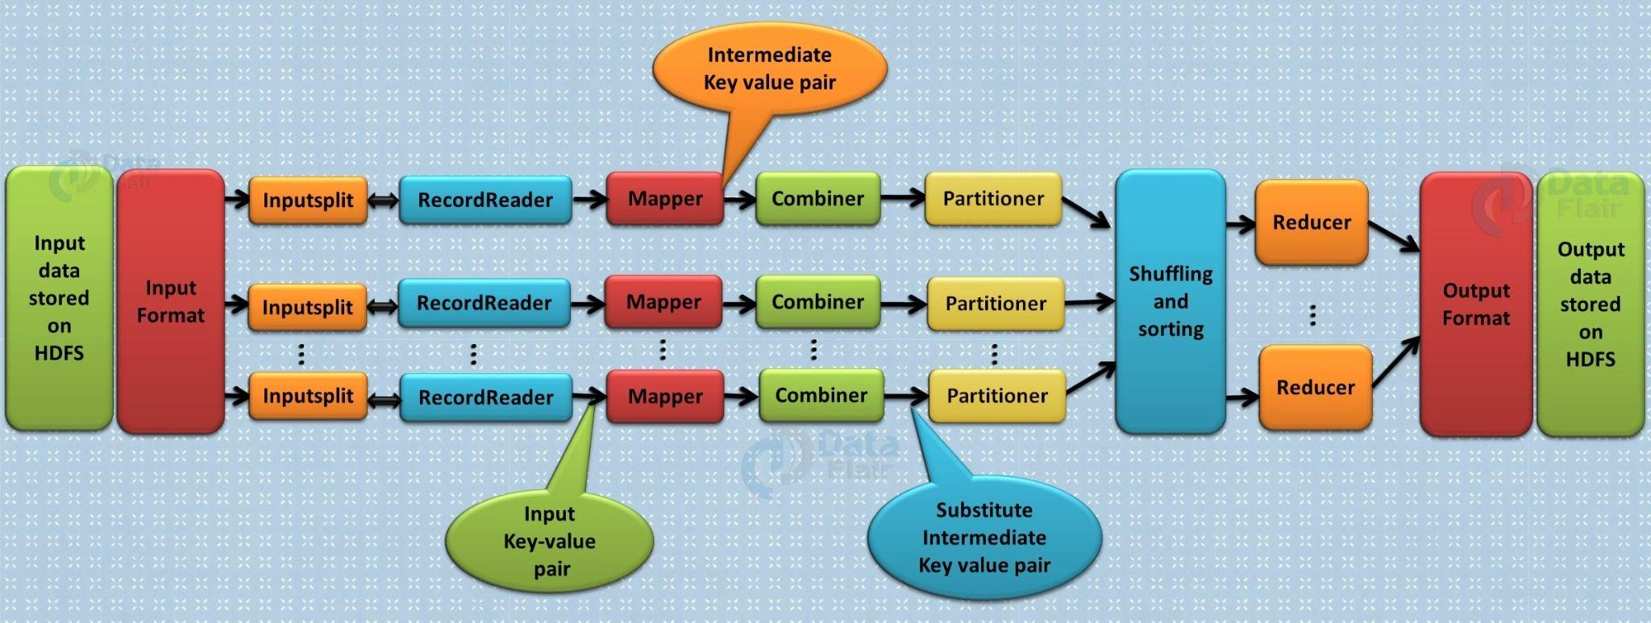
Final Overview

Slide 11
Thank You

